Slide 1
Evaluating the effectiveness of non-contact pressure monitoring via multispectral imaging using Kubelka-Munk approach

Slide 2
Outline
Introduction
Diabetic Foot
Normalization
ROI
Table
Summary

Slide 3
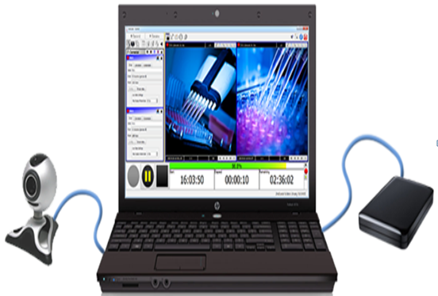
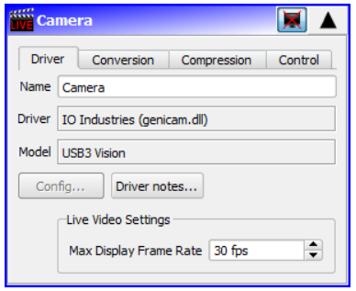
Introduction
2ndlook software
Video recording software

Slide 4
Cont…
Multi Spectral Imaging
Captures image data within specific wavelength ranges
Revealing details beyond human vision
Biomedical Multispectral Imaging System
Have 4 bands suitable for detecting hemoglobin and lipid
735, 800, 865, and 930 nm
Used for a number of analysis
oxygen saturation and total hemoglobin
Important for monitoring tissue health

Slide 5
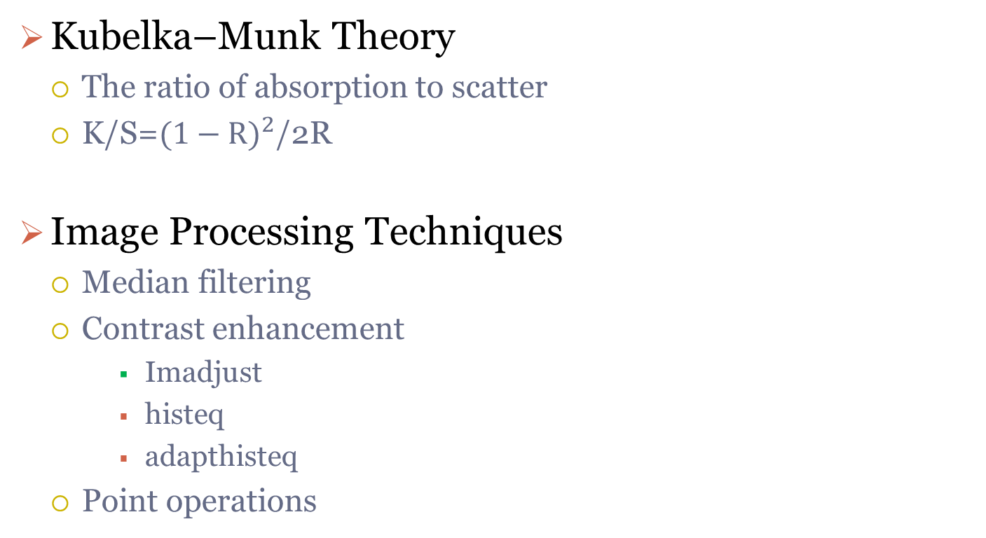
Cont…
Kubelka–Munk Theory
The ratio of absorption to scatter
K/S=${(1−R)}^{2}$/2R
Image Processing Techniques
Median filtering
Contrast enhancement
Imadjust
histeq
adapthisteq
Point operations

Slide 6
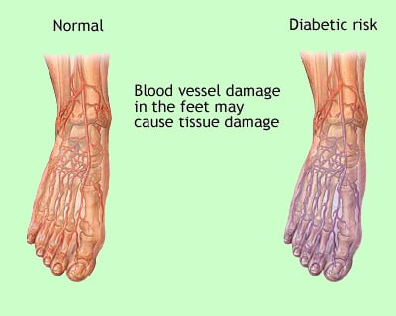
Diabetic Foot
Too high blood glucose, or sugar level
Doppler is ratio between flow at brachial artery and the ankle
Normal ABI ranges from 1.0 — 1.4

Slide 7
Parameters
Standard Normal Variate (SNV): (Img-mean)/std
Kurtosis: heavy/light-tailed relative to Normal Dist.
Skewness: Measure of symmetry
Energy: the amount of information
Mean
Std
Entropy: amount of uncertainty
Power Spectral Density (PSD)
Resolution: width per pixel
FDR: Fisher Discriminant Ration

Slide 8
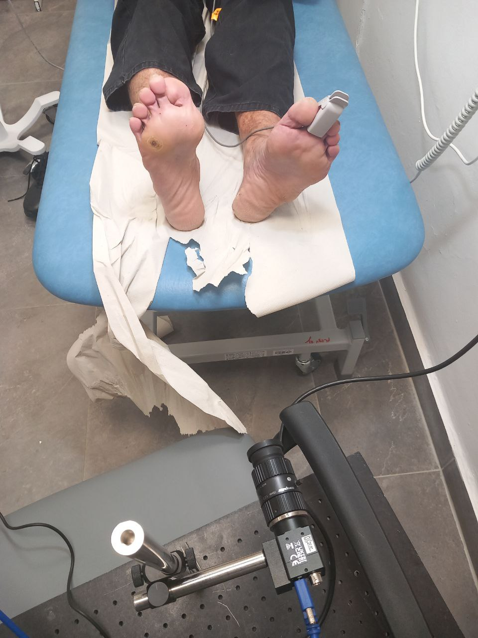
Patient Details(Subject#16)
Gender: Male
Saturation:
left: 95
right: 98
Age: 58
Left: Normal
Right: Pressure
Resolution: 0.004 cm/px
Distance:36 cm
Exp date: 25/02/25

Slide 9
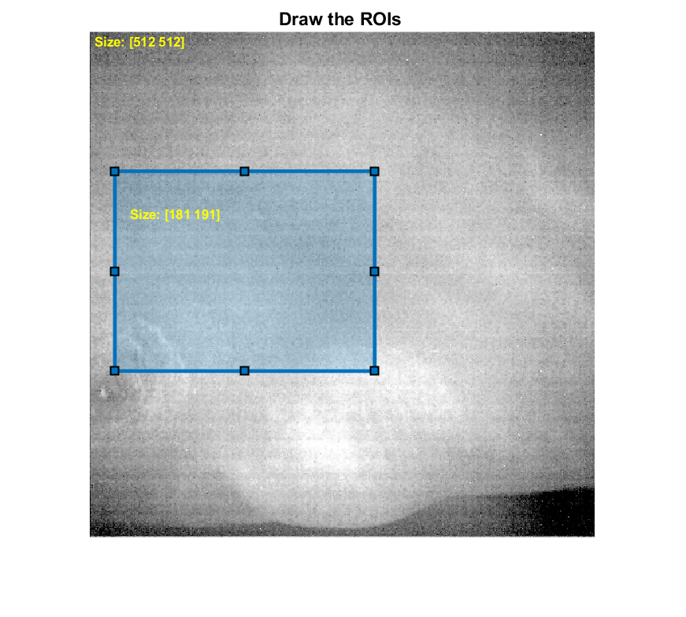
Normalization (ROI)

Slide 10

Leg Position
Normal Foot Diabetic Foot

Slide 11
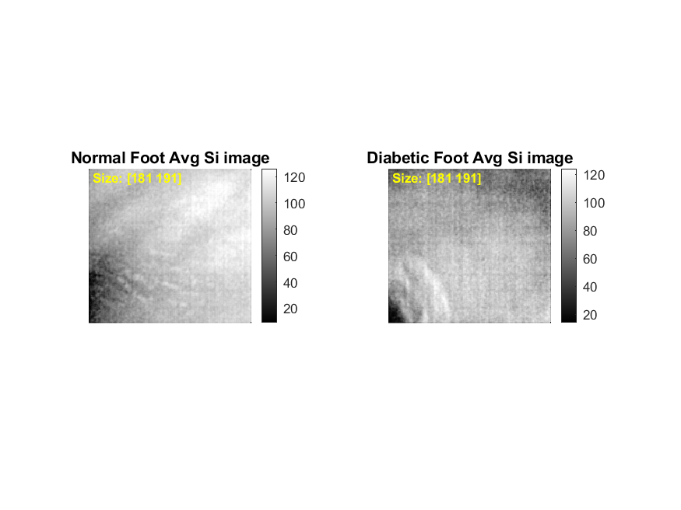
Average (n=26) Si Images @930 nm

Slide 12
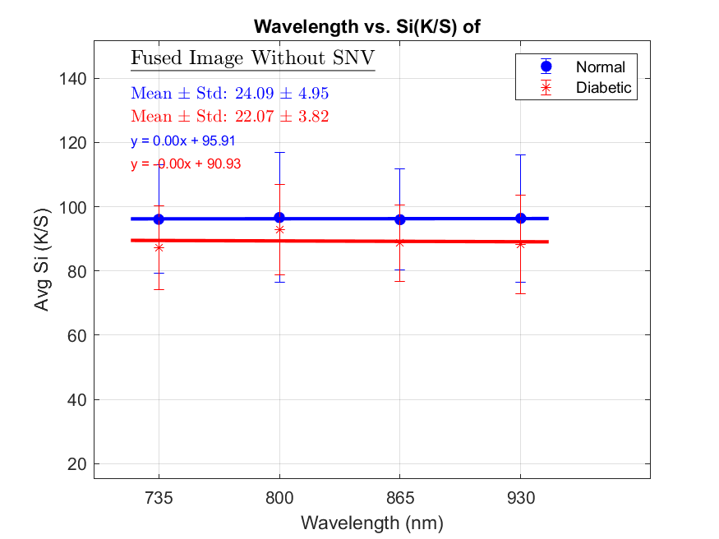
Avg Si of 26 images
Fused Image without SNV 47.44±4.23|58.93±5.69

Slide 13
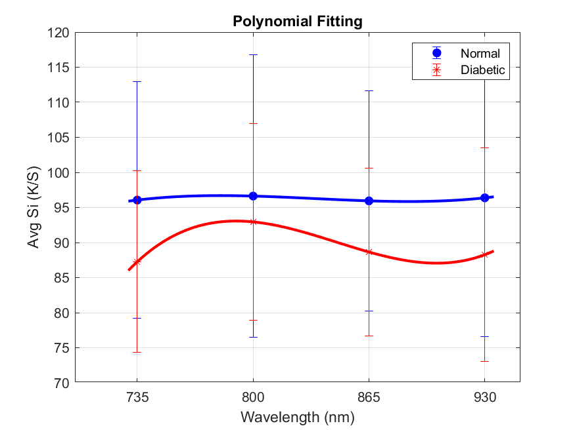
Avg SI Vs. Wavelength

Slide 14
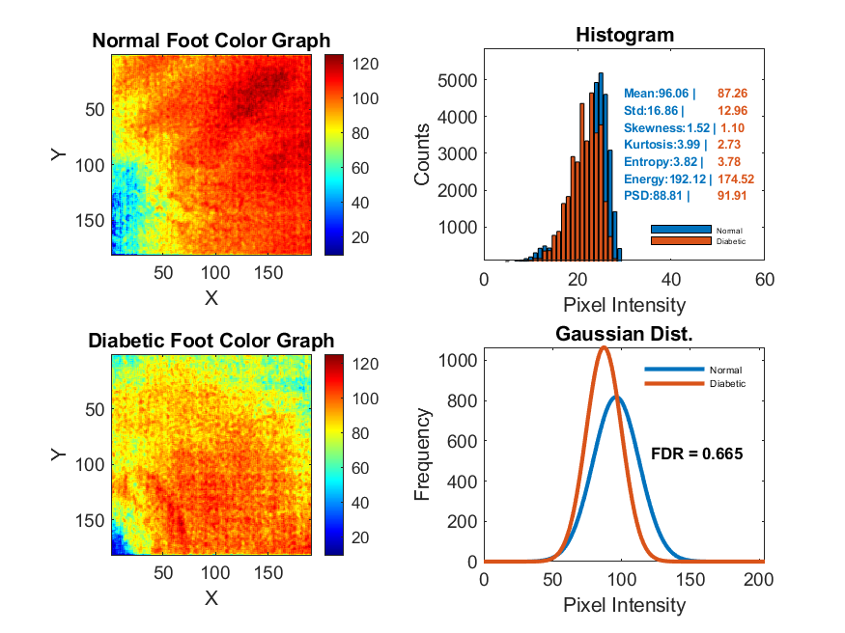
Normal Vs. Diabetic Foot (735 nm)

Slide 15
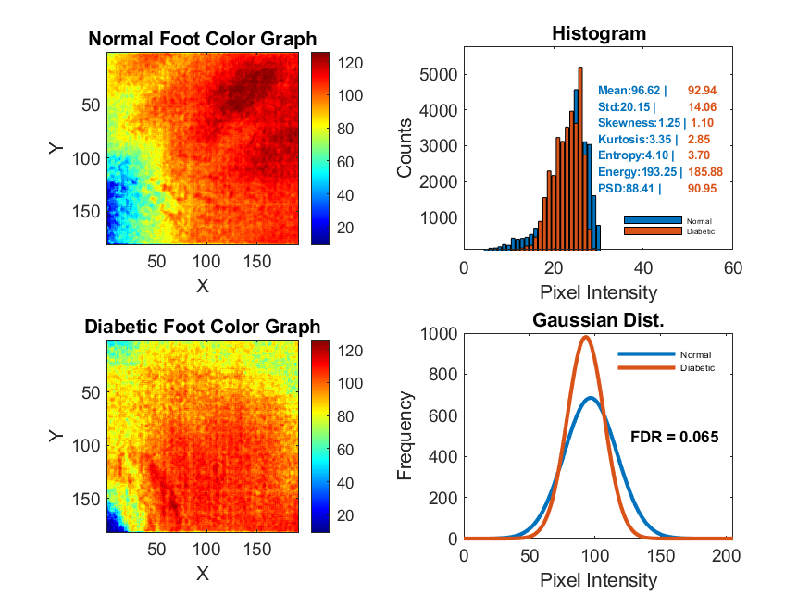
Normal Vs. Diabetic Foot (800 nm)

Slide 16
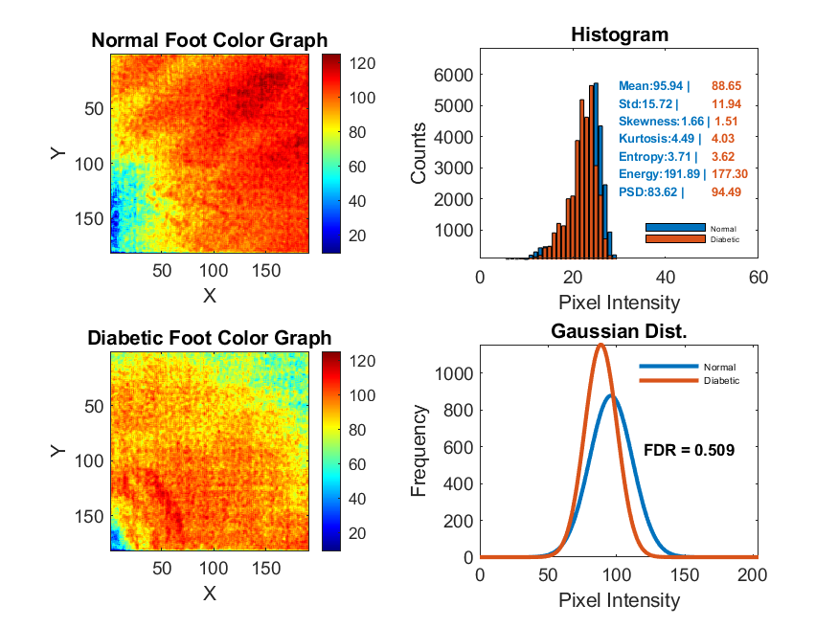
Normal Vs. Diabetic Foot (865 nm)

Slide 17
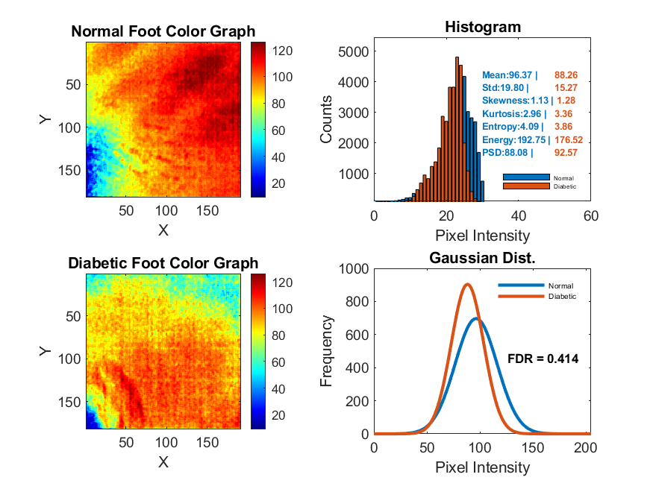
Normal Vs. Diabetic Foot (930 nm)

Slide 18
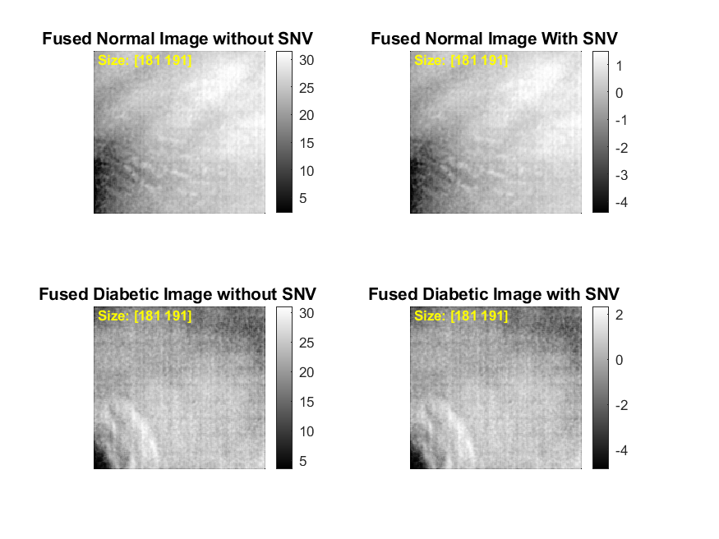
Fused Images
It is average image of all wavelength

Slide 19
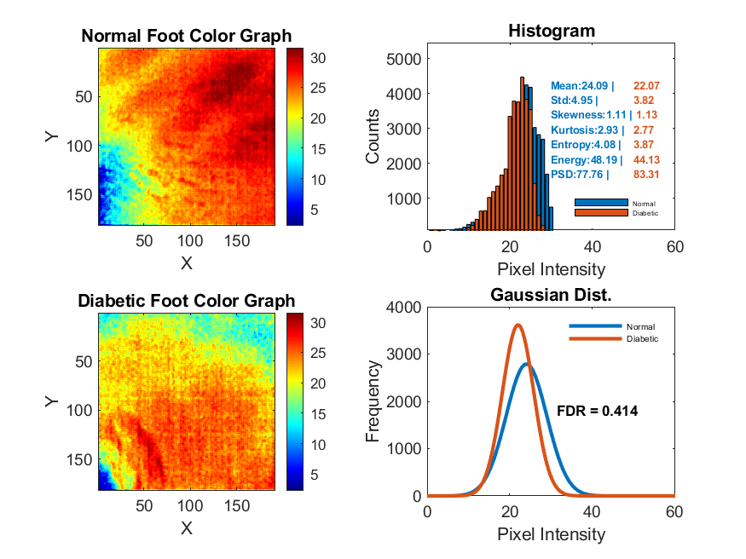
Fused Normal Vs. Diabetic Images (Without SNV)

Slide 20
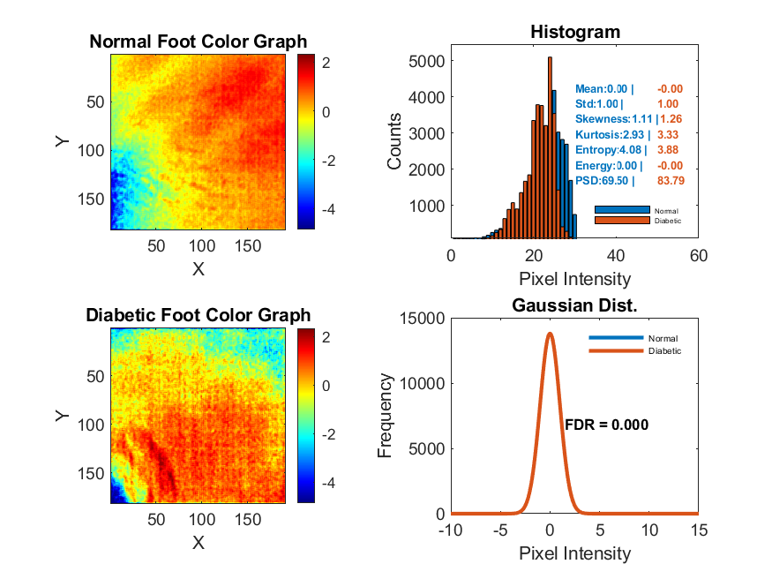
Fused Normal Vs. Diabetic Images (With SNV)

Slide 21
Relative Difference (threshold above 10%)
wavelength | 735 nm |  |  | 800 nm |  |  | 865 nm |  |  | 930 nm |  |  | Fused (Without SNV) |  |  | Fused (With SNV)
Params | Normal | Diabetic | Change(%) | Normal | Diabetic | Change(%) | Normal | Diabetic | Change(%) | Normal | Diabetic | Change(%) | Normal | Diabetic | Change(%) | Normal | Diabetic | Change(%)
Mean | 96.06 | 87.26 | 9.16 | 96.62 | 92.94 | 3.81 | 95.94 | 88.65 | 7.6 | 96.37 | 88.26 | 8.42 | 24.09 | 22.07 | 8.42 | 0 | 0 | 0
Std | 16.86 | 12.96 | 23.14 | 20.15 | 14.06 | 30.25 | 15.72 | 11.94 | 24.05 | 19.8 | 15.27 | 22.89 | 4.95 | 3.82 | 22.89 | 1 | 1 | 0
Skewness | 1.52 | 1.1 | 27.6 | 1.25 | 1.1 | 11.47 | 1.66 | 1.51 | 8.86 | 1.13 | 1.28 | 13.83 | 1.11 | 1.13 | 2.17 | 1.11 | 1.26 | 13.55
Kurtosis | 3.99 | 2.73 | 31.53 | 3.35 | 2.85 | 14.77 | 4.49 | 4.03 | 10.32 | 2.96 | 3.36 | 13.44 | 2.93 | 2.77 | 5.33 | 2.93 | 3.33 | 13.58
Entropy | 3.82 | 3.78 | 1.15 | 4.1 | 3.7 | 9.73 | 3.71 | 3.62 | 2.36 | 4.09 | 3.86 | 5.52 | 4.08 | 3.87 | 4.95 | 4.08 | 3.88 | 4.85
Energy | 192.12 | 174.52 | 9.16 | 193.25 | 185.88 | 3.81 | 191.89 | 177.3 | 7.6 | 192.75 | 176.52 | 8.42 | 48.19 | 44.13 | 8.42 | 0 | 0 | 0
PSD | 88.81 | 91.91 | 3.5 | 88.41 | 90.95 | 2.87 | 83.62 | 94.49 | 13 | 88.08 | 92.57 | 5.09 | 77.76 | 83.31 | 7.14 | 69.5 | 83.79 | 20.56
FDR |  |  | 0.67 |  |  | 0.07 |  |  | 0.50 |  |  | 0.41 |  |  |  | 0.41 |  | 0.00

Slide 22
Summary(#16)
Std
Highest change: 30.25% at 800 nm
Also high at 865 nm (24.05%), 930 nm (22.89%), and Fused (Without SNV) (22.89%)
Kurtosis
Highest change: 31.53% at 735 nm
Also notable at 930 nm (13.44%) and Fused (With SNV) (13.58%)
Skewness
High change: 27.6% at 735 nm
Still notable at 930 nm (13.83%) and Fused (With SNV) (13.55%)

Slide 23
FDR in all Diabetic Foot
735 nm | 800 nm | 865 nm | 930 nm | Remarks
4 | 5 | 7 | 3 | No Img Proc.
9 | 2 | 3 | 5 | Img Proc.
13 | 7 | 10 | 8 | Total

Slide 24
Thank You !

